Slide 1
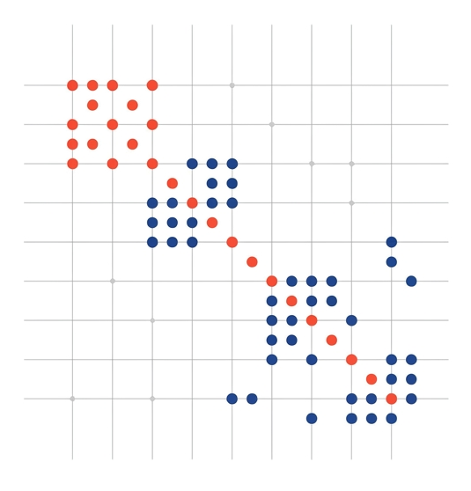
Sparse Matrices Analysis and Applications
Hesham Ashraf 202201477
Ahmed Wael 202201415

Slide 2
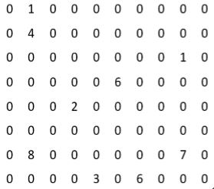
The Challenge of Scale
in scientific engineering, large systems of linear equations often involve matrices where most elements are zero.
Standard dense storage leads to quadratic memory growth O(n^2), making massive simulations computationally prohibitive on modern hardware.
Sparse matrix techniques enable efficient storage and specialized solvers that drastically reduce execution time and resource consumption.

Slide 3
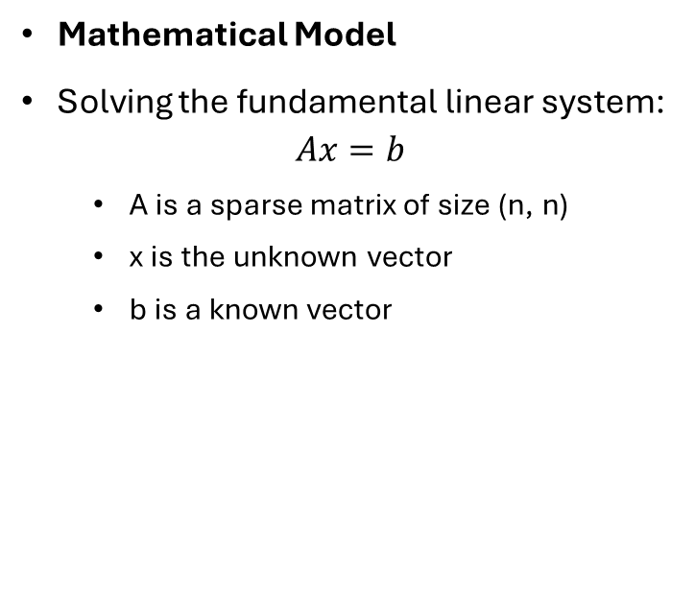
Problem Definition
Mathematical Model
Solving the fundamental linear system:
$$Ax=b$$
A is a sparse matrix of size (n, n)
x is the unknown vector
b is a known vector
Primary Objectives
Storage Optimization: Implement CSR and CSC representations.
Iterative Solving: Apply Jacobi and Gauss-Seidel iterations.
Performance Benchmarking: Evaluate scalability and accuracy.

Slide 4
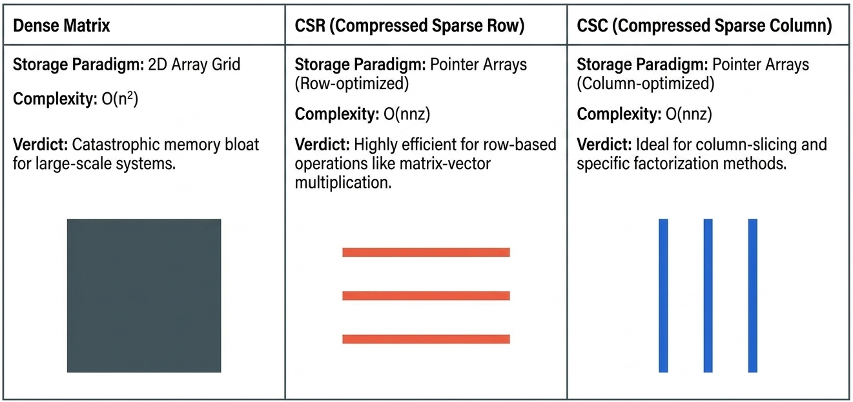
Storage Formats

Slide 5
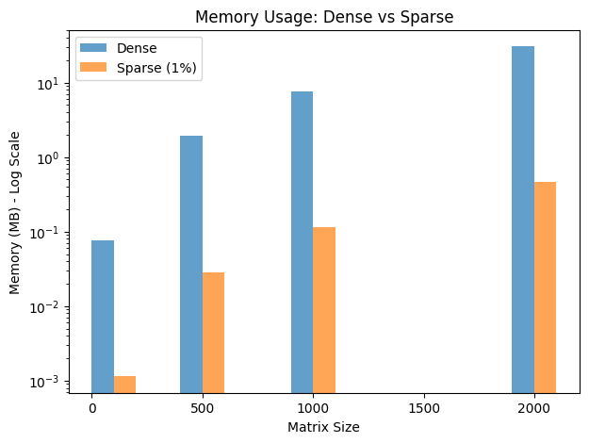
Memory Scalability Analysis

Slide 6
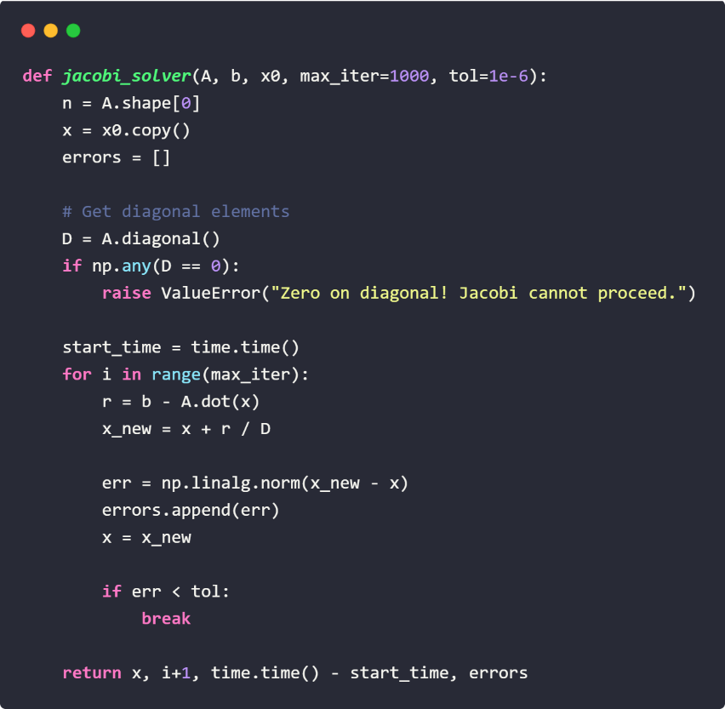

Iterative Solver Comparison
Jacobi Iteration
Updates all variables simultaneously using only values from the previous step.
Benefit: Highly parallelizable.
$$x^{\left(k | 1\right)}=D^{−1}\left(b−\left(L+U\right)x^{\left(k\right)}\right)$$

Slide 7
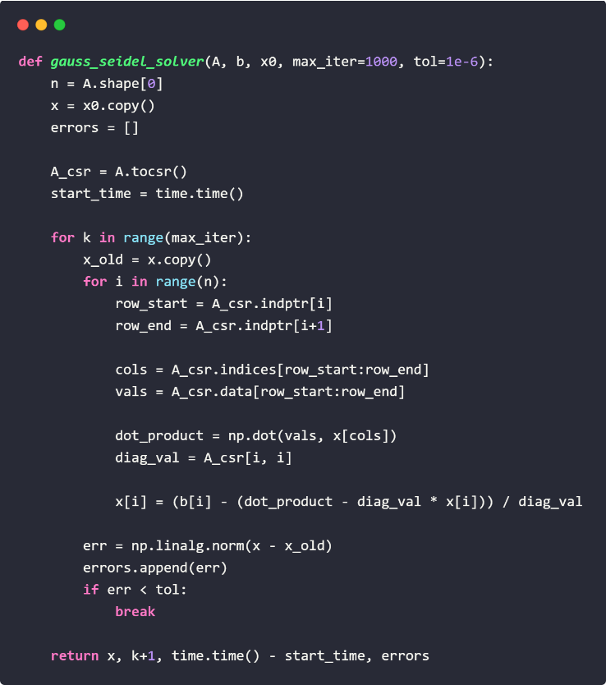

Iterative Solver Comparison
Gauss-Seidel Method
Uses newly computed values immediately within the current iteration.
Benefit: Faster convergence for most systems.
$$x^{\left(k | 1\right)}={\left(D+L\right)}^{−1}\left(b | Ux^{\left(k\right)}\right)$$

Slide 8
Solver Performance Benchmarks
Matrix Size | Jacobi Time | Jacobi Iter | Gauss-Seidel Time | Gauss-Seidel Iter | Direct Solver
100x100 | 0.0016 | 13 | 0.0156 | 9 | 0.0012
300x300 | 0.0002 | 11 | 0.0522 | 25 | 0.0013
500x500 | 0.0005 | 39 | 0.0809 | 11 | 0.0049
800x800 | 0.0008 | 60 | 0.1261 | 10 | 0.0290

Slide 9
Real-World Applications
Engineering (FEM)
Machine Learning
Data Science
Finite Element Method simulations for bridge and aerospace structural integrity.
Large-scale neural network weights and Graph Convolutional Networks (GCNs).
Recommendation systems and NLP involving high-dimensional sparse features.

Slide 10

Any Question?

Slide 11

Thank You

